Slide 1
Comparison between spaCy, ScispaCy and medspaCy
Luis Vizcaya

Slide 2
Description
In the following document I compare the number of entities recognized by spaCy, scispaCy and medspacy and graph the embeddings for each tool using t-SNE and UMAP.

Slide 3
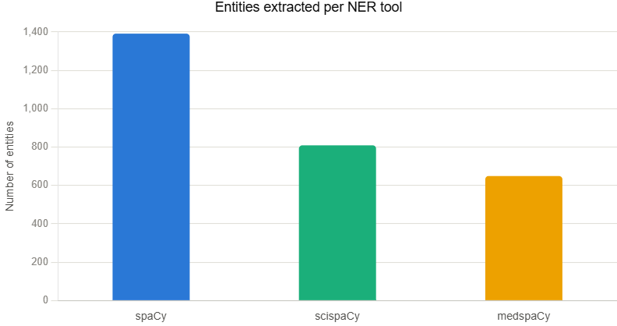
In the graph we can see that spaCy recognize more entities than scispaCy and medspaCy as it is expected as Spacy is a general tool while scispaCy and medspaCy are more specific tools.

Slide 4
spaCy Case

Slide 5
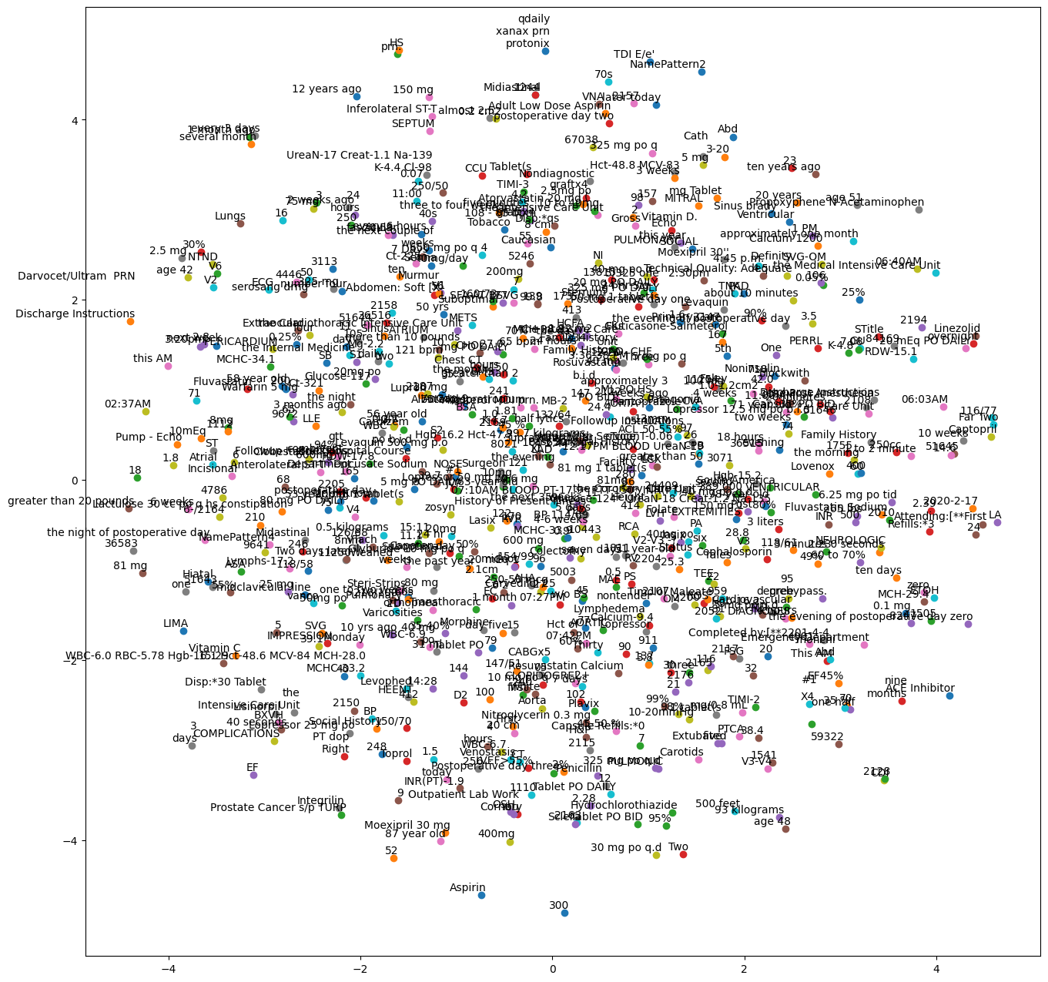
Entities Using spaCy and t-SNE

Slide 6
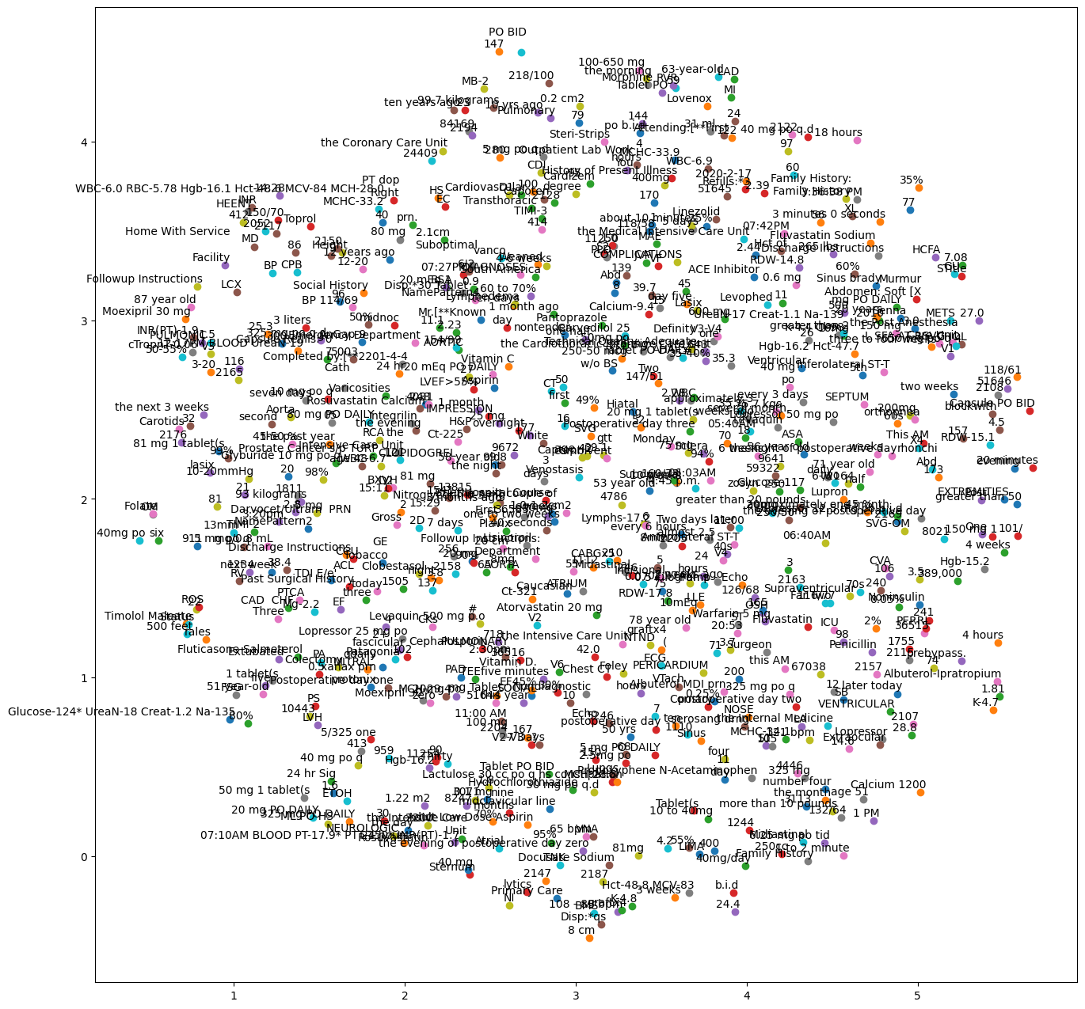
Entities Using spaCy and UMAP

Slide 7
ScispaCy Case

Slide 8
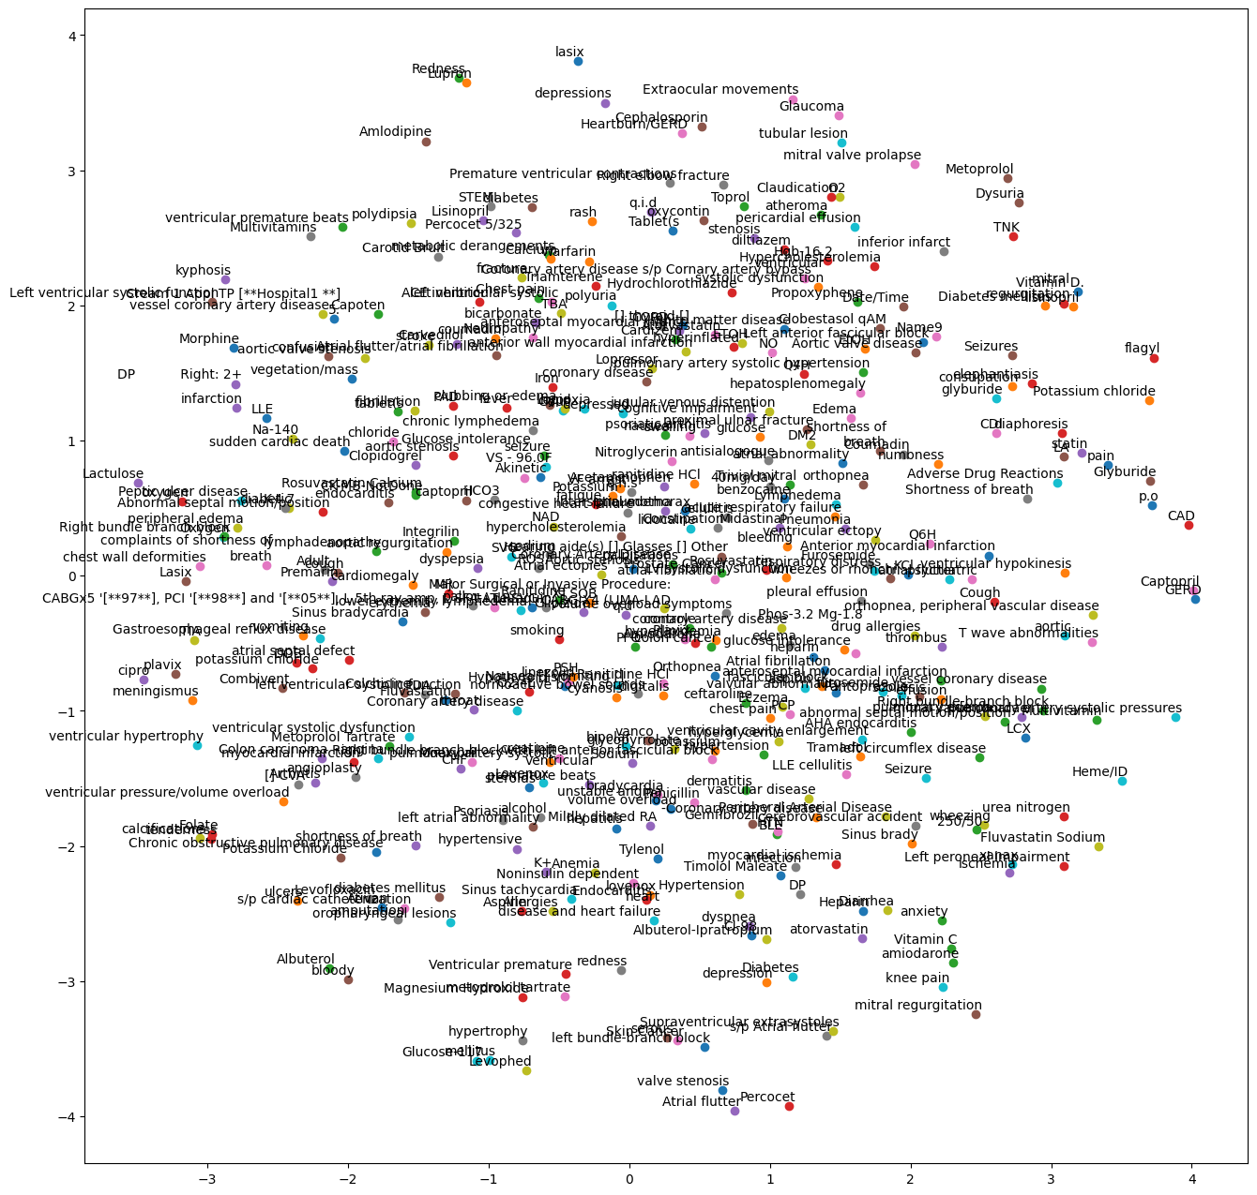
Entities Using ScispaCy and t-SNE

Slide 9
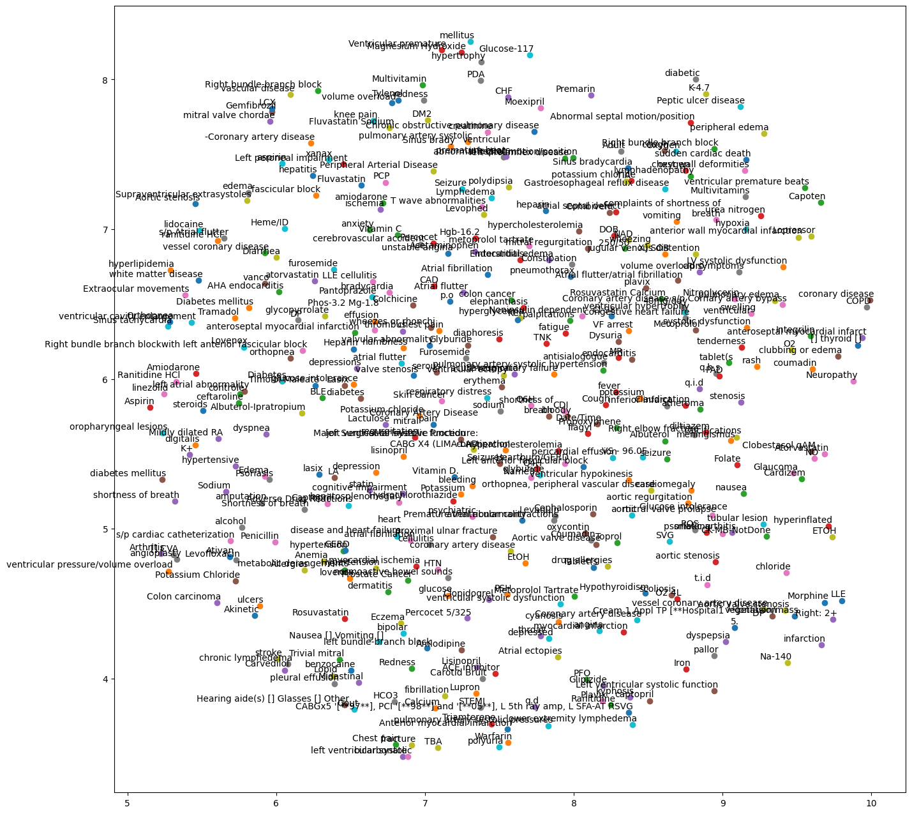
Entities Using ScispaCy and UMAP

Slide 10
MedspaCy Case

Slide 11
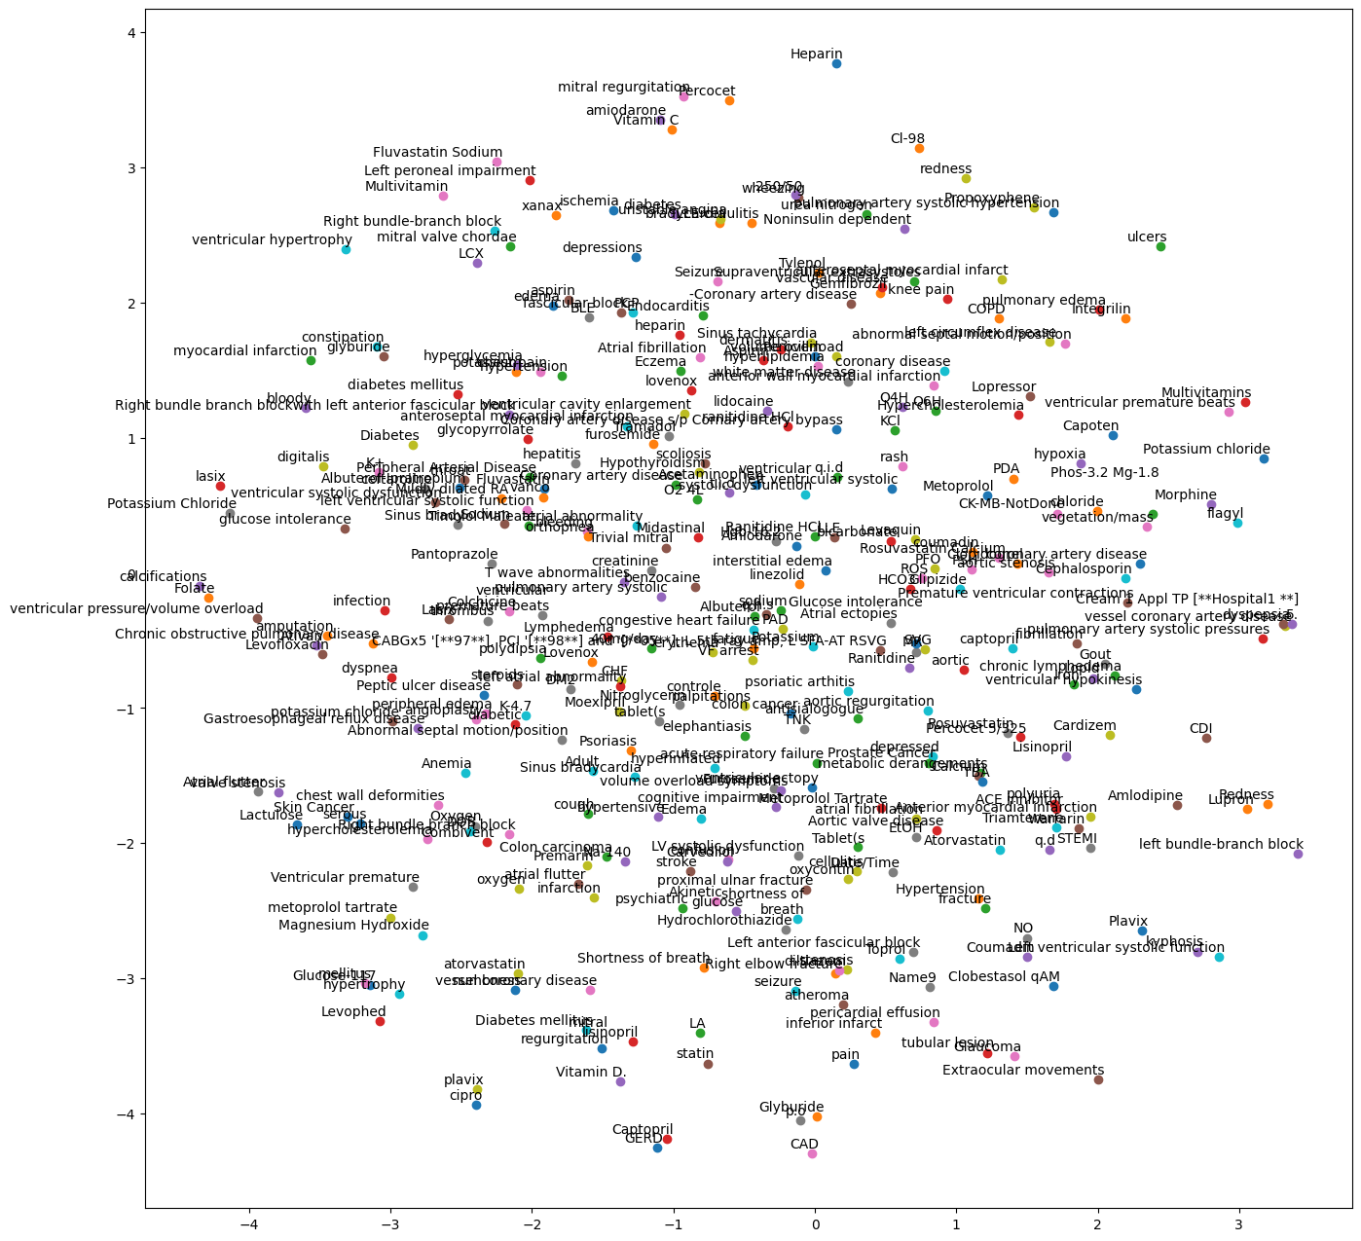
Entities Using medspaCy and t-SNE

Slide 12
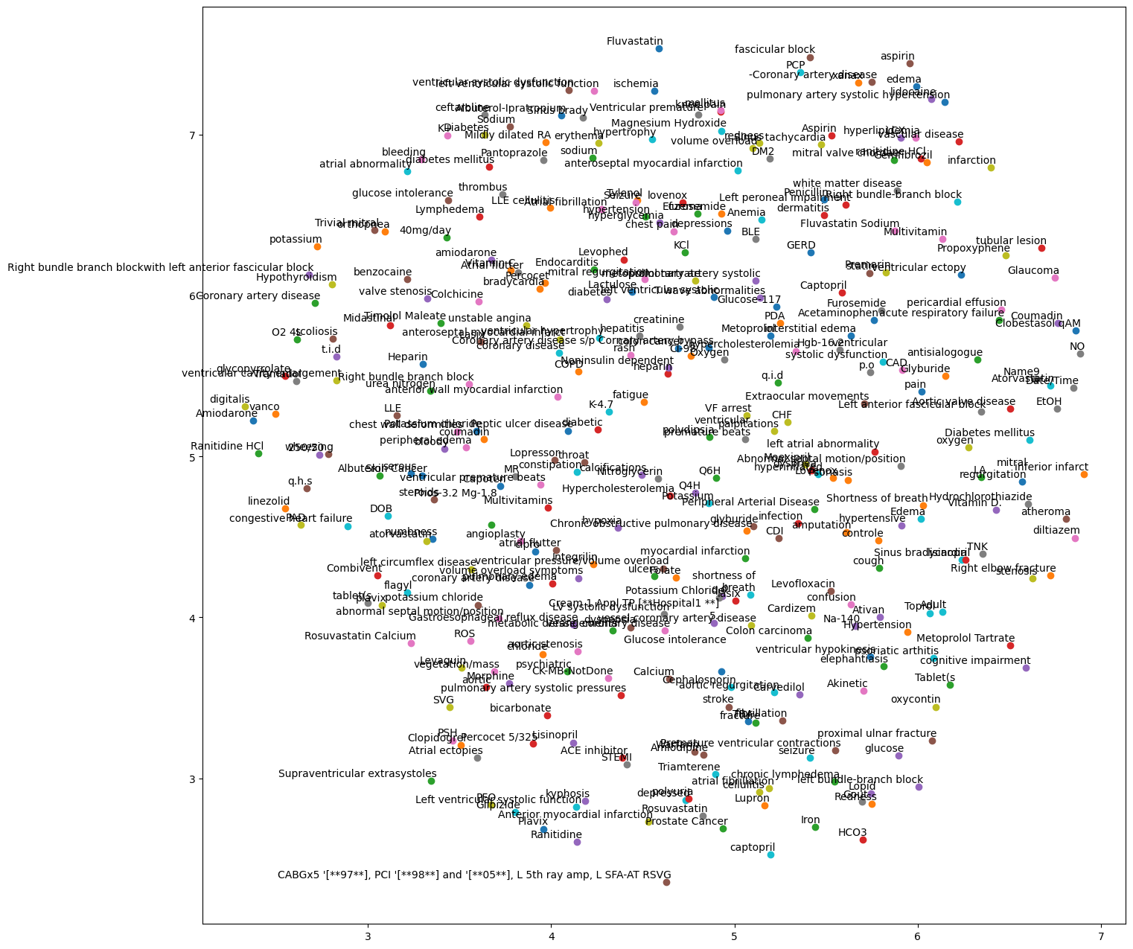
Entities Using medspaCy and UMAP

